Slide 1
PARALLEL AND DISTRIBUTED PROGRAMMING PARADIGMS
We define a parallel and distributed program as a parallel program running on a set of computing engines or a distributed computing system.
A distributed computing system is a set of computational engines connected by a network to achieve a common goal of running a job or an application.
  Ex: A computer cluster or network of workstations
Parallel computing is the simultaneous use of more than one computational engine (not necessarily connected via a network) to run a job or an application. For instance, parallel computing may use either a distributed or a nondistributed computing system such as a multiprocessor platform

Slide 2
Running a parallel program on a distributed computing system (parallel and distributed programming) has several advantages for both users and distributed computing systems.
From the users’ perspective, it decreases application response time;
From the distributed computing systems’ standpoint, it increases throughput and resource utilization.
Running a parallel program on a distributed computing system, however, could be a very complicated process.
- Therefore, data flow of running a typical parallel program on a distributed system is further explained in this chapter.

Slide 3
PARALLEL COMPUTING AND PROGRAMMING PARADIGMS
Consider a distributed computing system consisting of a set of networked nodes or workers.
The system issues for running a typical parallel program in either a parallel or a distributed manner would include the following:
• Partitioning: applicable to - computation & data:
• Computation partitioning : splits a given job or a program into smaller tasks. Partitioning greatly depends on correctly identifying portions of the job or program that can be performed concurrently.
• Data partitioning : splits the input or intermediate data into smaller pieces. Similarly, upon identification of parallelism in the input data, it can also be divided into pieces to be processed on different workers.

Slide 4
• Mapping: assigns the either smaller parts of a program or the smaller pieces of data to underlying resources.
• Synchronization: Because different workers may perform different tasks, synchronization and coordination among workers is necessary so that race conditions are prevented and data dependency among different workers is properly managed.
• Communication: Because data dependency is one of the main reasons for communication among workers, communication is always triggered when the intermediate data is sent to workers.
• Scheduling: For a job or program, when the number of computation parts (tasks) or data pieces is more than the number of available workers, a scheduler selects a sequence of tasks or data pieces to be assigned to the workers.
Note: Resource allocator performs actual mapping of computation or data pieces to workers, while scheduler only picks next part from the queue of unassigned tasks based on a set of rules called the scheduling policy.

Slide 5
MapReduce, Twister, and Iterative MapReduce
Formal Definition of MapReduce
MapReduce Logical Data Flow
Formal Notation of MapReduce Data Flow
Strategy to Solve MapReduce Problems
MapReduce Actual Data and Control Flow
Compute-Data Affinity
Twister and Iterative MapReduce

Slide 6
MapReduce
- is a software framework
- which supports parallel & distributed computing
- on large data sets.
Abstracts data flow of running a parallel program on a distributed computing system
- by providing users with two interfaces
- in the form of two functions: Map and Reduce.
Users can override these two functions to interact with & manipulate the data flow of running their programs.
In this framework,
“value” part of the data, (key, value), is actual data & “key” part is only used by the MapReduce controller to control the data flow.

Slide 7
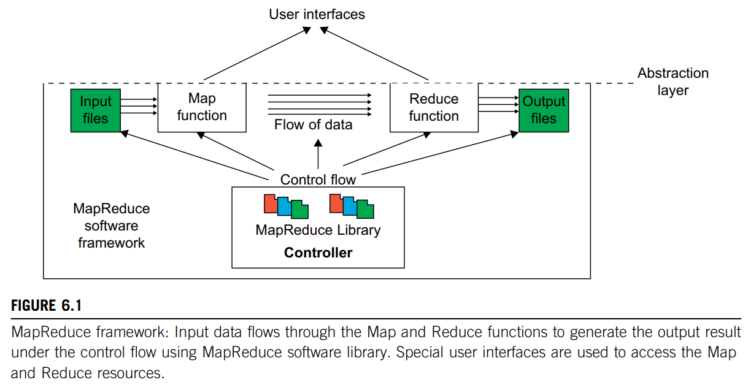
Figure 6.1 illustrates the logical data flow
- from Map to Reduce function in MapReduce frameworks.

Slide 8
FORMAL DEFINITION OF MAPREDUCE
MapReduce software framework
- provides an abstraction layer
- with data flow and flow of control to users,
- hides implementation of all data flow steps
- such as data partitioning, mapping, synchronization, communication, and scheduling.
Here, abstraction layer provides two well-defined interfaces in the form of two functions: Map and Reduce.
Figure 6.1 shows the MapReduce framework with data flow and control flow. Therefore, the user overrides the Map and Reduce functions first & then invokes the provided MapReduce (Spec, & Results) function from the library to start the flow of data.

Slide 9
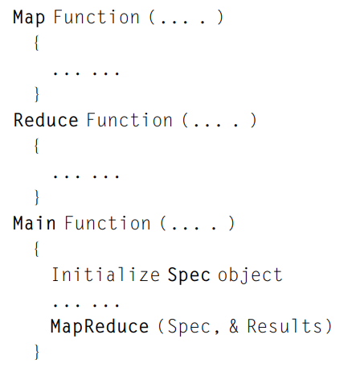
MapReduce (Spec, & Results), takes an important parameter which is a specification object, the Spec.
This object is first initialized inside the user’s program, & then user writes code to fill it with names of input and output files, as well as other optional tuning parameters.
This object is also filled with the name of the Map and Reduce functions to identify these user defined functions to the MapReduce library.
The overall structure of a user’s program containing the Map, Reduce, and the Main functions is shown here.
The Map and Reduce are two major subroutines. They will be called to implement the desired function performed in the main program.

Slide 10
MAPREDUCE LOGICAL DATA FLOW
The input data to both the Map and the Reduce functions has a particular structure.
This also pertains for the output data.
The input data to the Map function is in the form of a (key, value) pair.
For example, the key is the line offset within the input file and the value is the content of the line.
The output data from the Map function is structured as (key, value) pairs called intermediate (key, value) pairs.
In other words, the user-defined Map function processes each input (key, value) pair and produces a number of (zero, one, or more) intermediate (key, value) pairs.
Here, the goal is to process all input (key, value) pairs to the Map function in parallel (Figure 6.2).

Slide 11
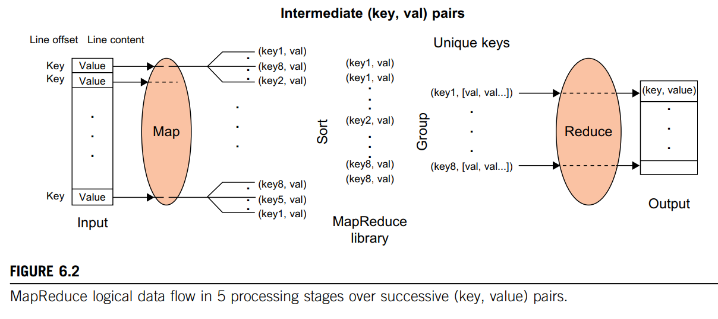

Slide 12
In turn, the Reduce function receives the intermediate (key, value) pairs in the form of a group of intermediate values associated with one intermediate key, (key, [set of values]).
In fact, the MapReduce framework forms these groups by first sorting the intermediate (key, value) pairs and then grouping values with the same key.
Note: data is sorted to simplify the grouping process.
Reduce function processes each (key, [set of values]) group & produces a set of (key, value) pairs as output.
To clarify the data flow in a sample MapReduce application, one of the well-known MapReduce problems, namely word count, to count the number of occurrences of each word in a collection of documents is presented here.

Slide 13
Figure 6.3 demonstrates the data flow of the word-count problem for a simple input file containing only two lines as follows:
(1) “most people ignore most poetry” and
(2) “most poetry ignores most people.”
In this case, the Map function simultaneously produces a number of intermediate (key, value) pairs for each line of content so that each word is the intermediate key with 1 as its intermediate value; for example, (ignore, 1).
Then the MapReduce library collects all the generated intermediate (key, value) pairs and sorts them to group the 1’s for identical words; for example, (people, [1,1]).
Groups are then sent to the Reduce function in parallel so that it can sum up the 1 values for each word and generate the actual number of occurrence for each word in the file; for example, (people, 2).

Slide 14
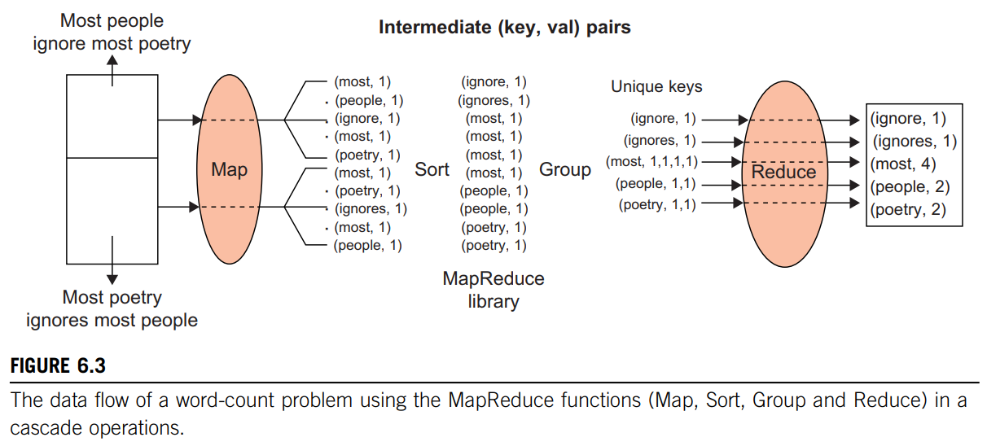

Slide 15


FORMAL NOTATION OF MAPREDUCE DATA FLOW
The Map function is applied in parallel to every input (key, value) pair, and produces new set of intermediate (key, value) pairs as follows:
Then the MapReduce library collects all the produced intermediate (key, value) pairs from all input (key, value) pairs, and sorts them based on the “key” part.
It then groups the values of all occurrences of the same key.
Finally, the Reduce function is applied in parallel to each group producing the collection of values as output as illustrated here:

Slide 16
STRATEGY TO SOLVE MAPREDUCE PROBLEMS
As mentioned earlier, after grouping all the intermediate data, the values of all occurrences of the same key are sorted and grouped together.
As a result, after grouping, each key becomes unique in all intermediate data.
Therefore, finding unique keys is the starting point to solving a typical MapReduce problem.
Then the intermediate (key, value) pairs as the output of the Map function will be automatically found.

Slide 17
The following three examples explain how to define keys and values in such problems:
Problem 1: Counting the number of occurrences of each word in a collection of documents
Solution: unique “key”: each word, intermediate “value”: number of occurrences
Problem 2: Counting the number of occurrences of words having the same size, or the same number of letters, in a collection of documents
Solution: unique “key”: each word, intermediate “value”: size of the word
Problem 3: Counting the number of occurrences of anagrams in a collection of documents. Anagrams are words with the same set of letters but in a different order (e.g., the words “listen” and “silent”).
Solution: unique “key”: alphabetically sorted sequence of letters for each word (e.g., “eilnst”), intermediate “value”: number of occurrences

Slide 18
MAPREDUCE ACTUAL DATA AND CONTROL FLOW
The main responsibility of the MapReduce framework is to efficiently run a user’s program on a distributed computing system.
Therefore, the MapReduce framework meticulously handles all partitioning, mapping, synchronization, communication, and scheduling details of such data flows.
We summarize this in the following distinct steps:
1. Data partitioning: The MapReduce library splits the input data (files), already stored in GFS, into M pieces that also correspond to the number of map tasks.
2. Computation partitioning: This is implicitly handled (in the MapReduce framework) by obliging users to write their programs in the form of the Map and Reduce functions.

Slide 19
3. Determining the master and workers:
The MapReduce architecture is based on a master worker model. Therefore, one of the copies of the user program becomes the master and the rest become workers.
Master picks idle workers & assigns the map and reduce tasks to them.
Steps 4–7 describe the map workers.
4. Reading the input data (data distribution): Each map worker reads its corresponding portion of the input data, namely the input data split, and sends it to its Map function.
5. Map function: Each Map function receives the input data split as a set of (key, value) pairs to process and produce the intermediated (key, value) pairs.

Slide 20
6. Combiner function: This is an optional local function within the map worker which applies to intermediate (key, value) pairs.
- user can invoke the Combiner function inside the user program.
- Combiner function merges the local data of each map worker before sending it over the network to effectively reduce its communication costs.
7. Partitioning function: As mentioned in our discussion of the MapReduce data flow, the intermediate (key, value) pairs with identical keys are grouped together because all values inside each group should be processed by only one Reduce function to generate the final result.
However, in real implementations, since there are M map and R reduce tasks, intermediate (key, value) pairs with the same key might be produced by different map tasks, although they should be grouped and processed together by one Reduce function only.

Slide 21
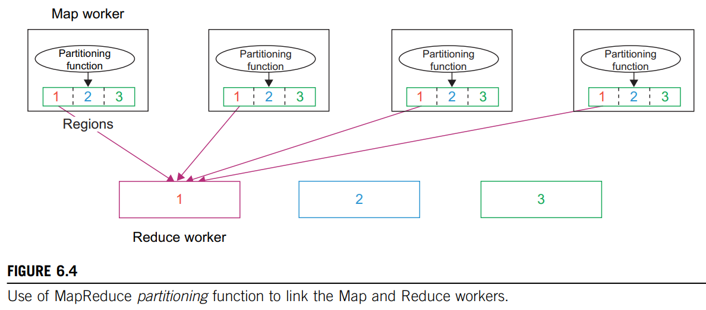
Therefore, the intermediate (key, value) pairs produced by each map worker are partitioned into R regions, equal to the number of reduce tasks, by the Partitioning function to guarantee that all (key, value) pairs with identical keys are stored in the same region.
As a result, since reduce worker i reads the data of region i of all map workers, all (key, value) pairs with the same key will be gathered by reduce worker i accordingly (see Figure 6.4).

Slide 22
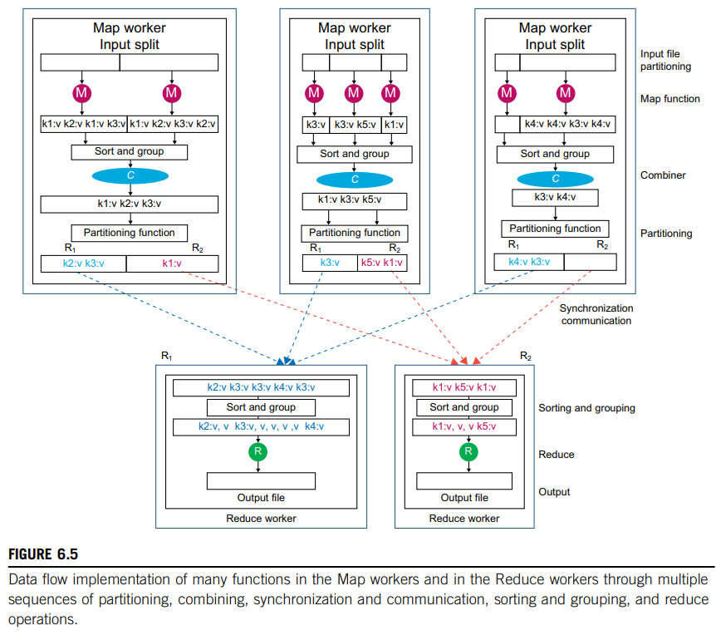
To implement this technique, a Partitioning function could simply be a hash function (e.g., Hash(key) mod R) that forwards the data into particular regions.
Figure 6.5 shows the data flow implementation of all data flow steps.

Slide 23
The following are two networking steps:
8. Synchronization: MapReduce applies a simple synchronization policy to coordinate map workers with reduce workers, in which the communication between them starts when all map tasks finish.
9. Communication: Reduce worker i, already notified of the location of region i of all map workers, uses a remote procedure call to read the data from the respective region of all map workers.
Since all reduce workers read the data from all map workers, all-to-all communication among all map and reduce workers, which incurs network congestion, occurs in the network.
This issue is one of the major bottlenecks in increasing the performance of such systems.
A data transfer module was proposed to schedule data transfers independently.
Steps 10 and 11 correspond to the reduce worker domain.

Slide 24
10. Sorting and Grouping: When the process of reading the input data is finalized by a reduce worker, the data is initially buffered in the local disk of the reduce worker.
Then the reduce worker groups intermediate (key, value) pairs by sorting the data based on their keys, followed by grouping all occurrences of identical keys.
Note: buffered data is sorted and grouped because the number of unique keys produced by a map worker may be more than R regions in which more than one key exists in each region of a map worker (see Figure 6.4).
11. Reduce function: The reduce worker iterates over the grouped (key, value) pairs, and for each unique key, it sends the key and corresponding values to the Reduce function.
Then this function processes its input data and stores the output results in predetermined files in the user’s program.

Slide 25
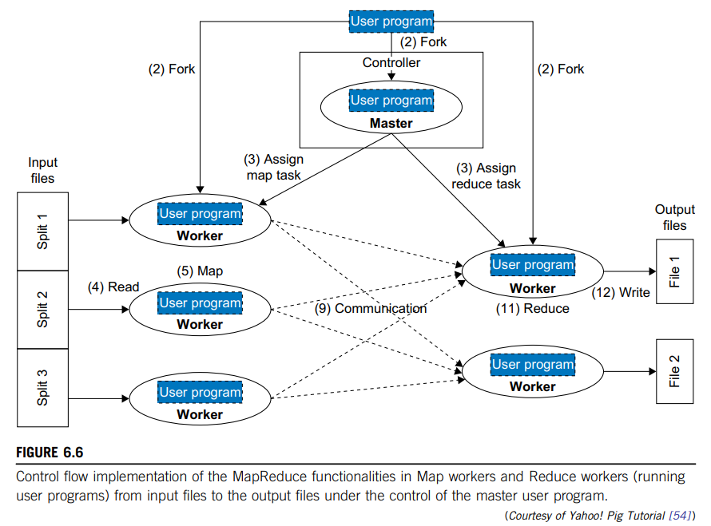
To better clarify the interrelated data control and control flow in the MapReduce framework, Figure 6.6 shows the exact order of processing control in such a system contrasting with dataflow in Figure 6.5.

Slide 26
COMPUTE-DATA AFFINITY
MapReduce framework - first proposed & implemented by Google.
First implementation was coded in C.
Implementation takes advantage of GFS - as the underlying layer.
GFS is a distributed file system where files are divided into fixed-size blocks (chunks) & blocks are distributed and stored on cluster nodes.
MapReduce could perfectly adapt itself to GFS.
MapReduce library splits the input data (files) into fixed-size blocks, and ideally performs the Map function in parallel on each block.
In this case, as GFS has already stored files as a set of blocks, the MapReduce framework just needs to send a copy of the user’s program containing the Map function to the nodes’ already stored data blocks.
This is the notion of sending computation toward data rather than sending data toward computation.
Note: Default GFS block size is 64 MB which is identical to that of the MapReduce framework

Slide 27
TWISTER AND ITERATIVE MAPREDUCE
It is important to understand the performance of different runtimes and, in particular, to compare MPI and MapReduce.
Two major sources of parallel overhead are:
load imbalance & communication (synchronization)
The communication overhead in MapReduce can be quite high, for two reasons:
1) MapReduce reads and writes via files, whereas MPI transfers information directly between nodes over the network.
2) MPI does not transfer all data from node to node, but just the amount needed to update information.
We can call the MPI flow δ flow and the MapReduce flow full data flow.

Slide 28
We can address the performance issues with two important changes:
1. Stream information between steps without writing intermediate steps to disk.
2. Use long-running threads or processors to communicate the δ (between iterations) flow.
These changes will lead to major performance increases at the cost of poorer fault tolerance & ease to support dynamic changes such as the number of available nodes.
The Twister programming paradigm and its implementation architecture at run time are illustrated in Figure 6.7(a, b).
Twister distinguishes the static data which is never reloaded from the dynamic δ flow that is communicated

Slide 29
